Slide 1
Discrete Mathematics: Lecture 27 Part IV. Graph Theory Euler’s Formula, Homeomorphic, Kuratowski's Theorem, Graph Coloring
Xuming He
Associate Professor
School of Information Science and Technology
ShanghaiTech University
Spring Semester, 2024
Notes by Prof. Liangfeng Zhang & Noemie Legout

Slide 2
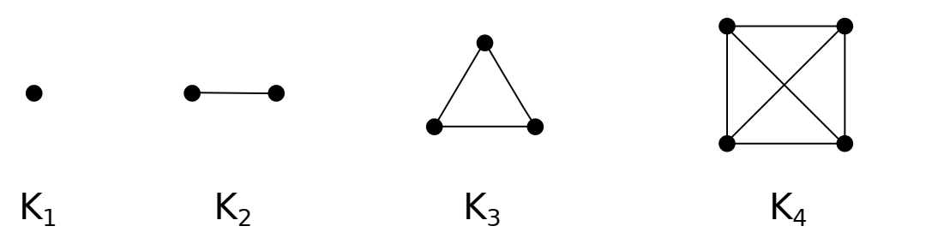
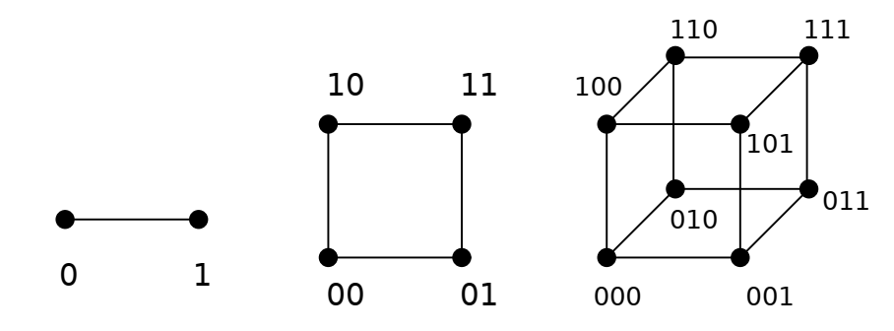
Review: Planar Graph
DEFINITION: Let $G=(V,E)$ be an undirected graph. $G$ is called a planar
graph平面图 if it can be drawn in the plane without any edges crossing.
Crossing of edges: an intersection other than endpoints (vertices)
planar representation平面表示: a drawing w/o edge crossing; nonplanar非平面的
$K_{1}, K_{2},K_{3}, K_{4}$ are planar graphs
$K_{1,n}, K_{2,n}$ are planar graphs
$C_{n} (n≥3), W_{n}(n≥3)$ are planar graphs
$Q_{1},Q_{2},Q_{3}$ are planar graphs

Slide 3


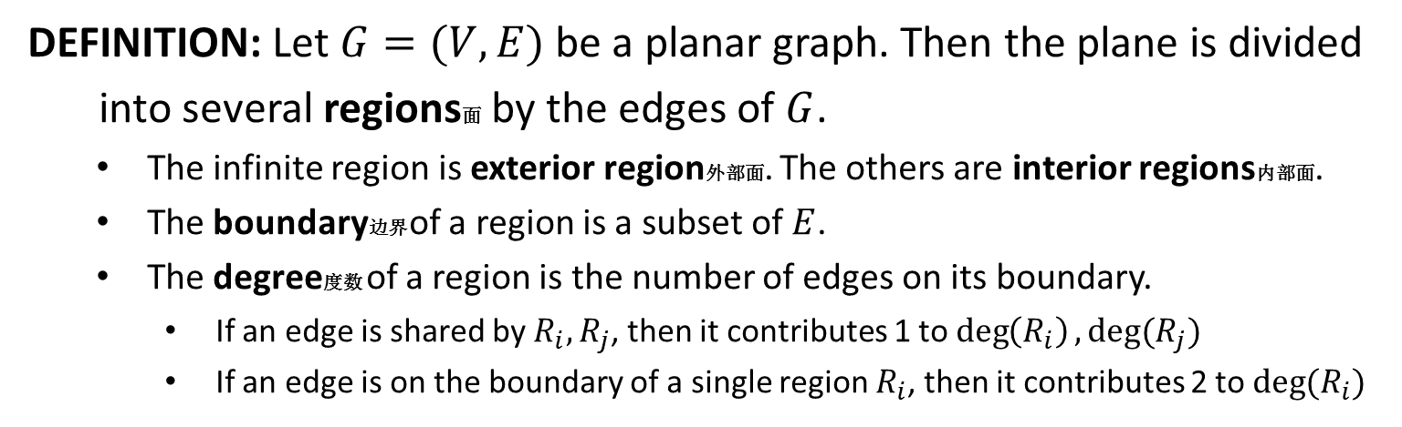







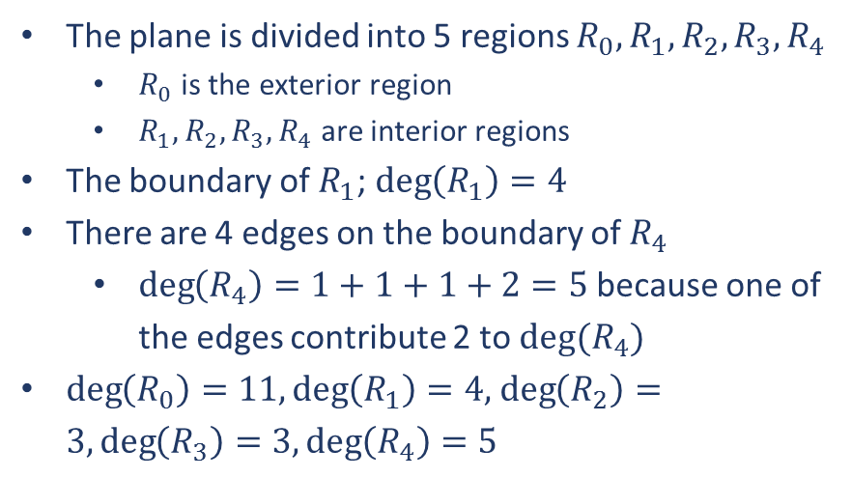
Review: Regions
DEFINITION: Let $G=(V,E)$ be a planar graph. Then the plane is divided
into several regions面 by the edges of $G$.
The infinite region is exterior region外部面. The others are interior regions内部面.
The boundary边界 of a region is a subset of $E$.
The degree度数 of a region is the number of edges on its boundary.
If an edge is shared by $R_{i},R_{j}$, then it contributes 1 to $\deg\left(R_{i}\right), deg(R_{j})$
If an edge is on the boundary of a single region $R_{i}$, then it contributes 2 to $deg⁡(R_{i})$
$$a$$
$$b$$
The plane is divided into 5 regions $R_{0},R_{1},R_{2},R_{3},R_{4}$
$R_{0}$ is the exterior region
$R_{1},R_{2},R_{3},R_{4}$ are interior regions
The boundary of $R_{1}$; $\deg\left(R_{1}\right)=4$
There are 4 edges on the boundary of $R_{4}$
$\deg\left(R_{4}\right)=1+1+1+2=5$ because one of the edges contribute 2 to $deg⁡(R_{4})$
$\deg\left(R_{0}\right)=11,\deg\left(R_{1}\right)=4,$ $\deg\left(R_{2}\right)=3, \deg\left(R_{3}\right)=3, \deg\left(R_{4}\right)=5$
$$R_{1}$$
$$d$$
$$c$$
$$R_{2}$$
$$R_{4}$$
$$R_{3}$$
$$R_{0}$$

Slide 4
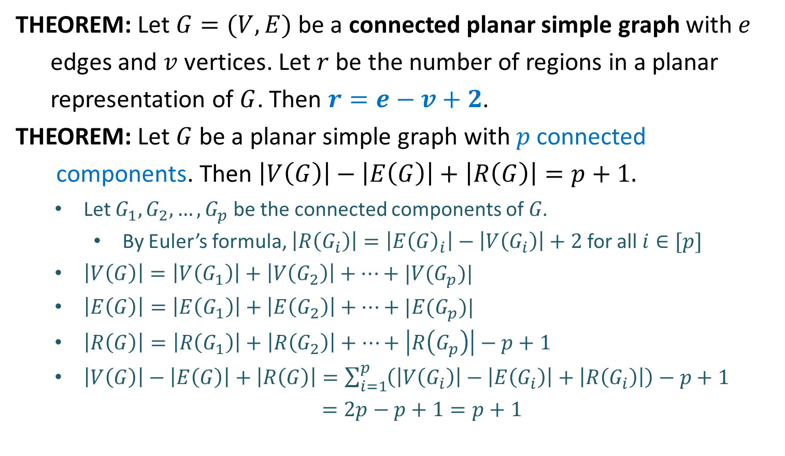
Euler’s Formula
THEOREM: Let $G=(V,E)$ be a connected planar simple graph with $e$
edges and $v$ vertices. Let $r$ be the number of regions in a planar
representation of $G$. Then $r=e−v+2$.
THEOREM: Let $G$ be a planar simple graph with $p$ connected
components. Then $\left|V\left(G\right)\right|−\left|E\left(G\right)\right|+\left|R\left(G\right)\right|=p+1.$
Let $G_{1}, G_{2},…,G_{p}$ be the connected components of $G$.
By Euler’s formula, $\left|R\left(G_{i}\right)\right|=\left|E{\left(G\right)}_{i}\right|−\left|V\left(G_{i}\right)\right|+2$ for all $i∈[p]$
$\left|V\left(G\right)\right|=\left|V\left(G_{1}\right)\right|+\left|V\left(G_{2}\right)\right|+⋯+|V(G_{p})|$
$\left|E\left(G\right)\right|=\left|E\left(G_{1}\right)\right|+\left|E\left(G_{2}\right)\right|+⋯+|E(G_{p})|$
$\left|R\left(G\right)\right|=\left|R\left(G_{1}\right)\right|+\left|R\left(G_{2}\right)\right|+⋯+\left|R\left(G_{p}\right)\right|−p+1$
$\left|V\left(G\right)\right|−\left|E\left(G\right)\right|+\left|R\left(G\right)\right|=\sum_{i=1}^{p}{\left(\left|V\left(G_{i}\right)\right|−\left|E\left(G_{i}\right)\right|+\left|R\left(G_{i}\right)\right|\right)}−p+1$
$=2p−p+1=p+1$

Slide 5
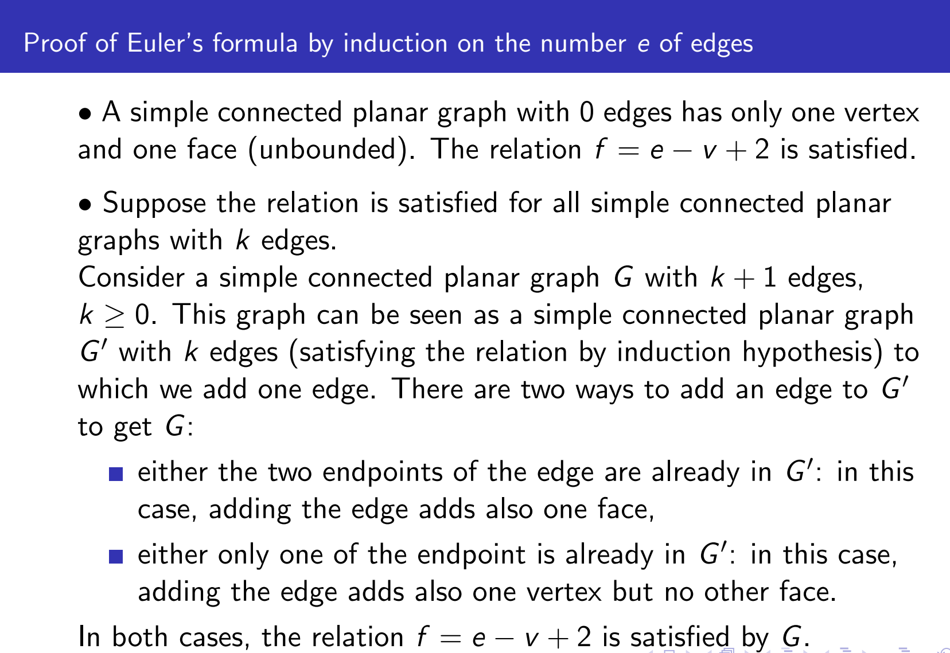
Euler’s Formula: Proof*

Slide 6
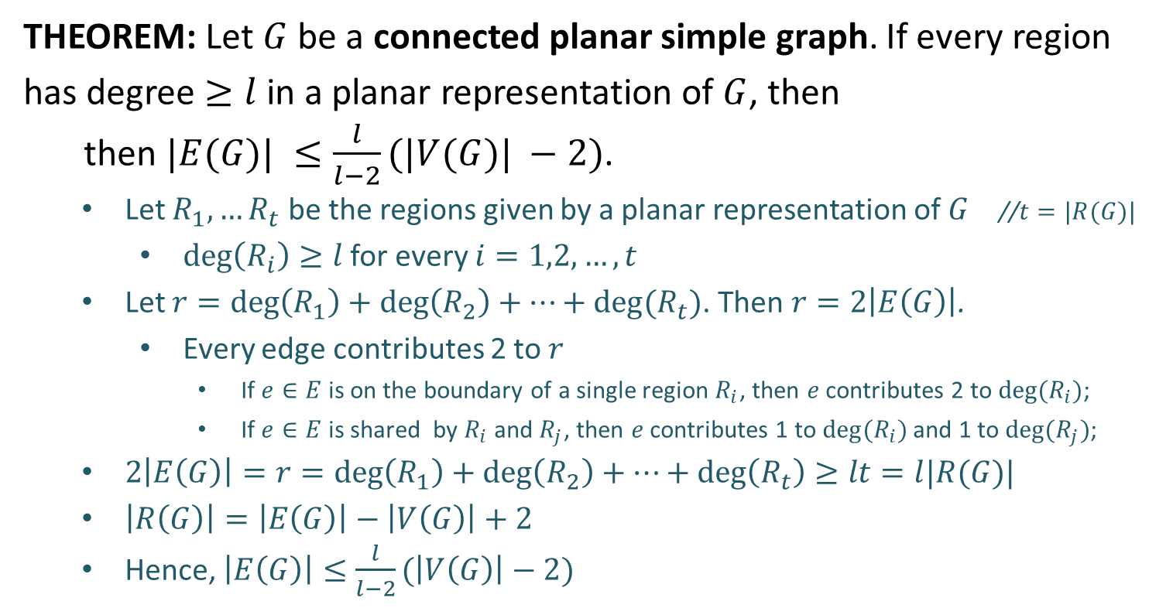
Application
THEOREM: Let $G$ be a connected planar simple graph. If every region has degree $≥l$ in a planar representation of $G$, then
then $|E(G)| ≤\frac{l}{l−2}(|V(G)| −2)$.
Let $R_{1},…R_{t}$ be the regions given by a planar representation of $G$ //$t=|R(G)|$
$\deg\left(R_{i}\right)≥l$ for every $i=1,2,…,t$
Let $r=\deg\left(R_{1}\right)+\deg\left(R_{2}\right)+⋯+\deg{(R_{t})}$. Then $r=2\left|E\left(G\right)\right|$.
Every edge contributes 2 to $r$
If $e∈E$ is on the boundary of a single region $R_{i}$, then $e$ contributes 2 to $\deg{(R_{i})}$;
If $e∈E$ is shared by $R_{i}$ and $R_{j}$, then $e$ contributes 1 to $\deg{(R_{i})}$ and 1 to $\deg{(R_{j})}$;
$2\left|E\left(G\right)\right|=r=\deg\left(R_{1}\right)+\deg\left(R_{2}\right)+⋯+\deg\left(R_{t}\right)≥lt=l|R(G)|$
$\left|R\left(G\right)\right|=\left|E\left(G\right)\right|−\left|V\left(G\right)\right|+2$
Hence, $\left|E\left(G\right)\right|≤\frac{l}{l−2}(\left|V\left(G\right)\right|−2)$

Slide 7
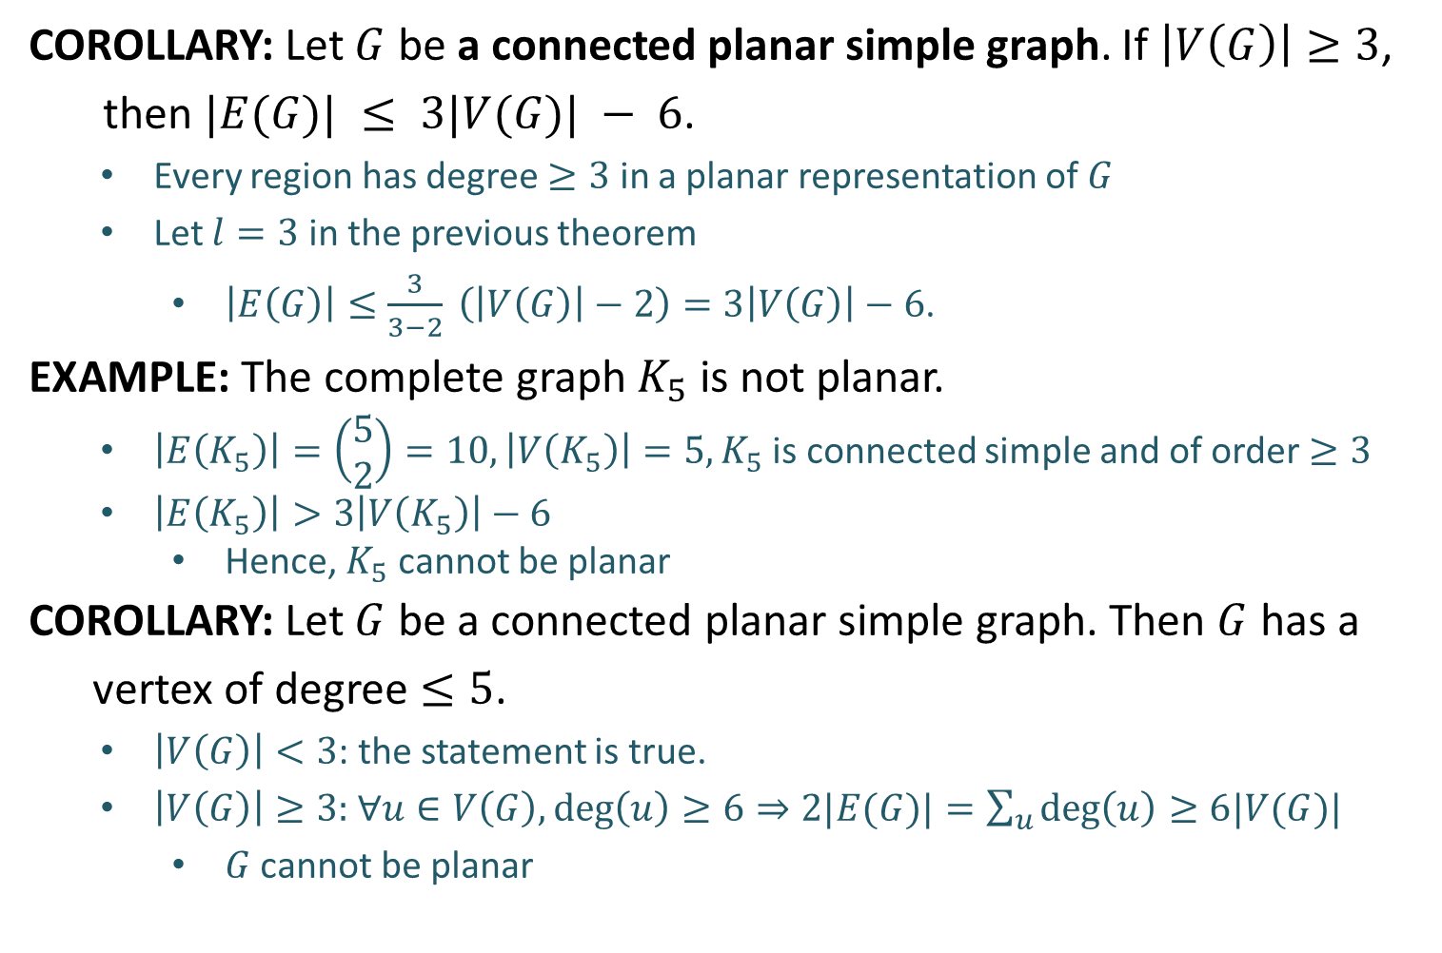
Application
COROLLARY: Let $G$ be a connected planar simple graph. If $\left|V\left(G\right)\right|≥3$,
then $|E(G)| ≤ 3|V(G)| − 6$.
Every region has degree $≥3$ in a planar representation of $G$
Let $l=3$ in the previous theorem
$\left|E\left(G\right)\right|≤\frac{3}{3−2} \left(\left|V\left(G\right)\right|−2\right)=3\left|V\left(G\right)\right|−6$.
EXAMPLE: The complete graph $K_{5}$ is not planar.
$\left|E\left(K_{5}\right)\right|=\left(\begin{aligned}5 \\ 2\end{aligned}\right)=10, \left|V\left(K_{5}\right)\right|=5, K_{5}$ is connected simple and of order $≥3$
$\left|E\left(K_{5}\right)\right|>3\left|V\left(K_{5}\right)\right|−6$
Hence, $K_{5}$ cannot be planar
COROLLARY: Let $G$ be a connected planar simple graph. Then $G$ has a
vertex of degree $≤5$.
$\left|V\left(G\right)\right|<3$: the statement is true.
$\left|V\left(G\right)\right|≥3:$ $∀u∈V\left(G\right),\deg\left(u\right)≥6⇒2|E(G)|=\sum_{u}{\deg\left(u\right)≥6|V(G)|}$
$G$ cannot be planar

Slide 8
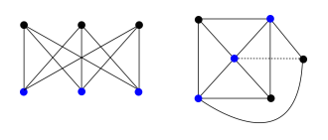
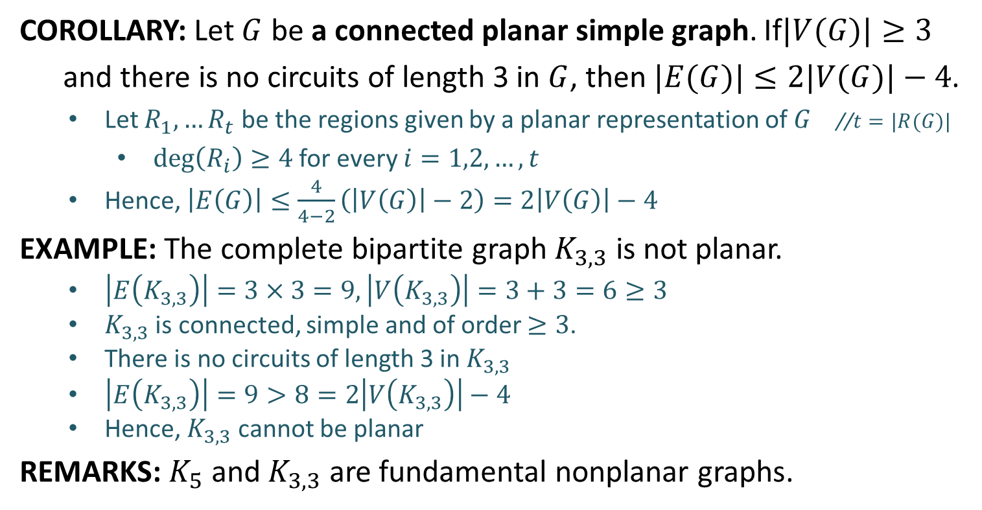
Application
COROLLARY: Let $G$ be a connected planar simple graph. If$|V(G)|≥3$
and there is no circuits of length 3 in $G$, then $|E(G)|≤2|V(G)|−4$.
Let $R_{1},…R_{t}$ be the regions given by a planar representation of $G$ //$t=|R(G)|$
$\deg\left(R_{i}\right)≥4$ for every $i=1,2,…,t$
Hence, $\left|E\left(G\right)\right|≤\frac{4}{4−2}\left(\left|V\left(G\right)\right|−2\right)=2\left|V\left(G\right)\right|−4$
EXAMPLE: The complete bipartite graph $K_{3,3}$ is not planar.
$\left|E\left(K_{3,3}\right)\right|=3×3=9, \left|V\left(K_{3,3}\right)\right|=3+3=6≥3$
$K_{3,3}$ is connected, simple and of order $≥3$.
There is no circuits of length 3 in $K_{3,3}$
$\left|E\left(K_{3,3}\right)\right|=9>8=2\left|V\left(K_{3,3}\right)\right|−4$
Hence, $K_{3,3}$ cannot be planar
REMARKS: $K_{5}$ and $K_{3,3}$ are fundamental nonplanar graphs.

Slide 9
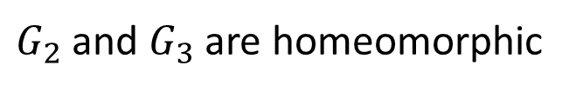
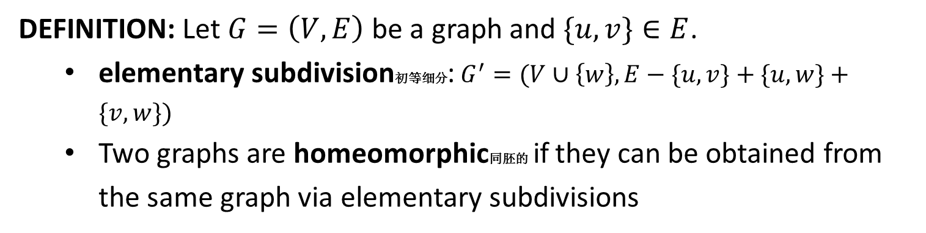
Homeomorphic
DEFINITION: Let $G=\left(V,E\right)$ be a graph and $\{u,v\}∈E$.
elementary subdivision初等细分: $G^{′}=(V∪\left\{w\right\}, E−\{u,v\}+\{u,w\}+\{v,w\})$
Two graphs are homeomorphic同胚的 if they can be obtained from the same graph via elementary subdivisions
$G_{2}$ and $G_{3}$ are homeomorphic

Slide 10
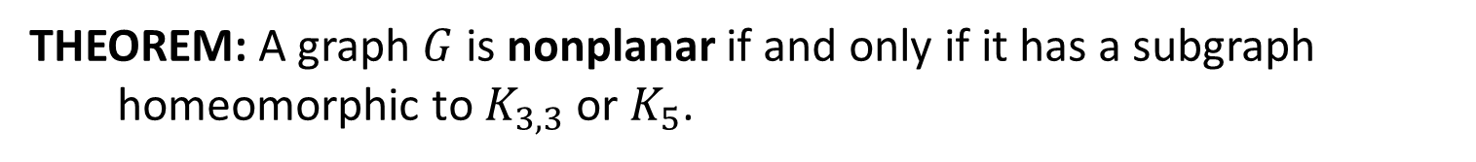
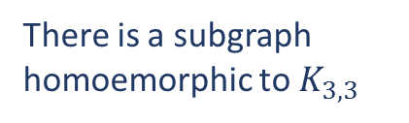
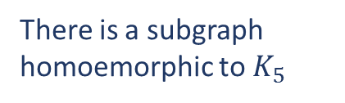
Kuratowski's Theorem
THEOREM: A graph $G$ is nonplanar if and only if it has a subgraph
homeomorphic to $K_{3,3}$ or $K_{5}$.
EXAMPLE: The following graph is nonplanar.
There is a subgraph
homoemorphic to $K_{5}$
There is a subgraph
homoemorphic to $K_{3,3}$

Slide 11
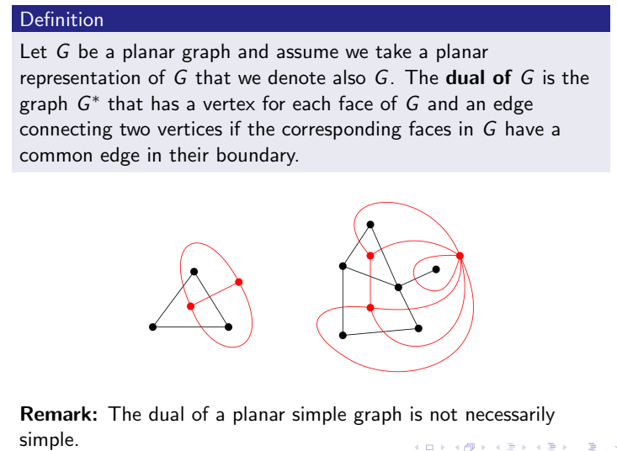
Dual Graph

Slide 12
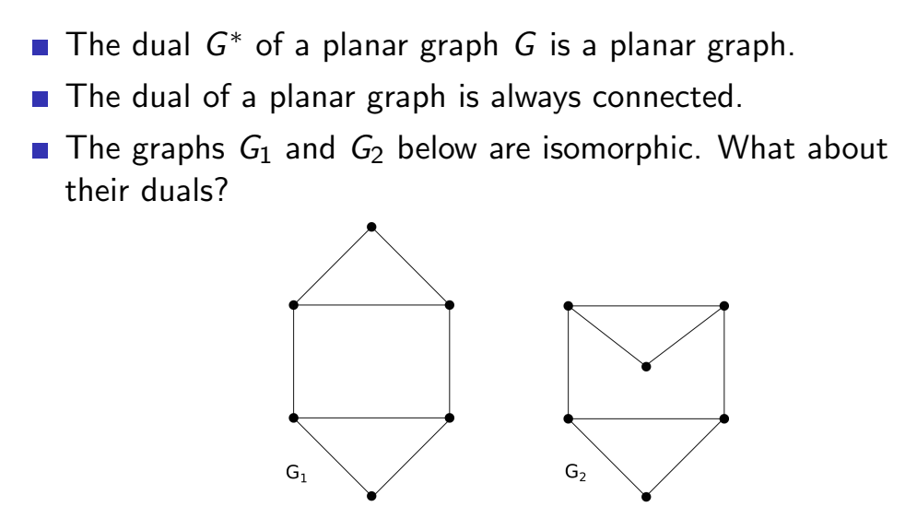
Dual Graph
Properties of dual graph

Slide 13
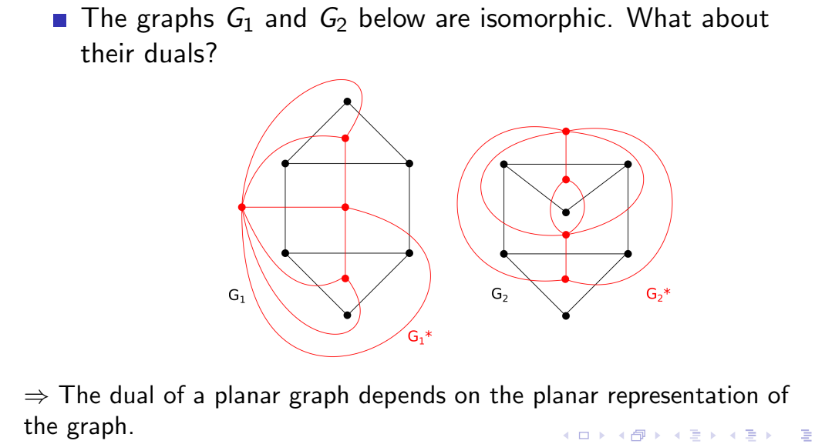
Dual Graph
Properties of dual graph

Slide 14
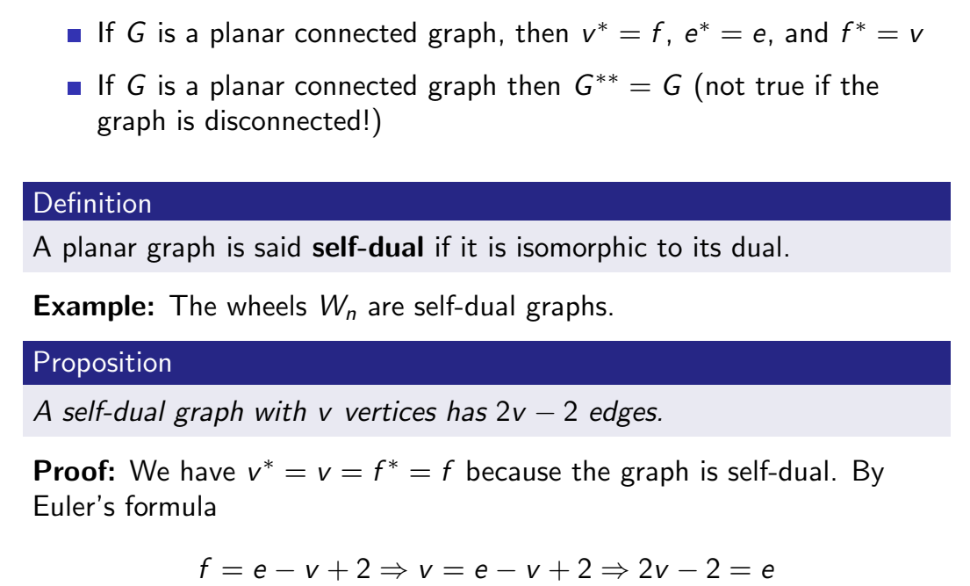
Dual Graph
Properties of dual graph

Slide 15
Dual Graph
Properties of dual graph

Slide 16
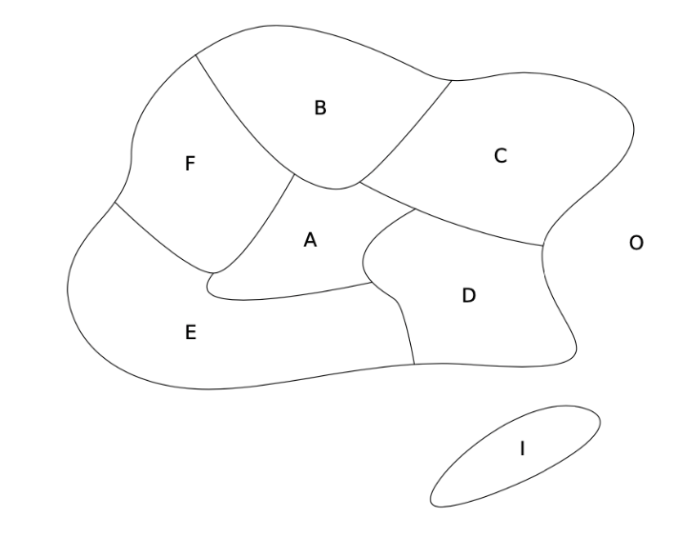
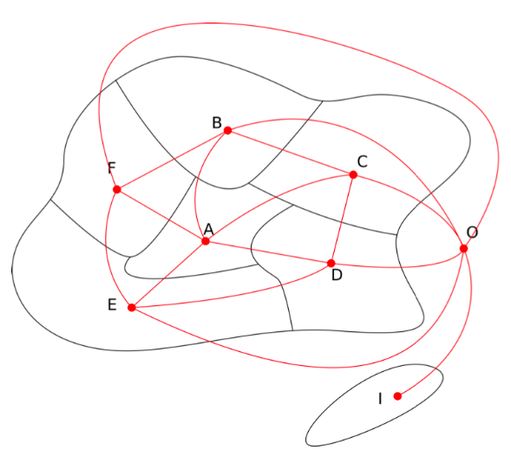
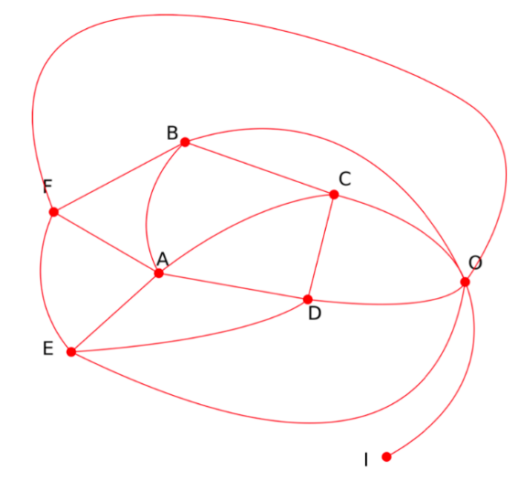
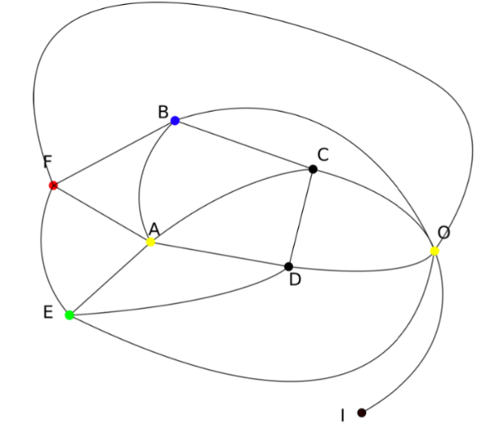
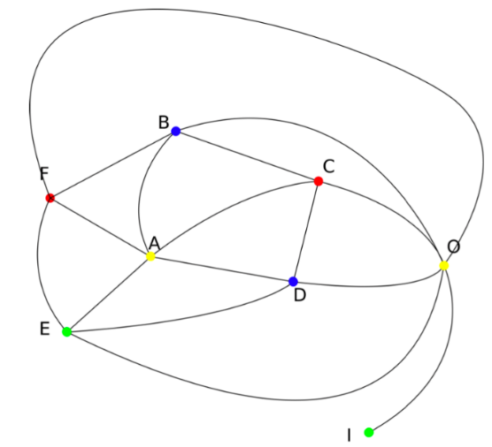
Coloring a Map

Slide 17
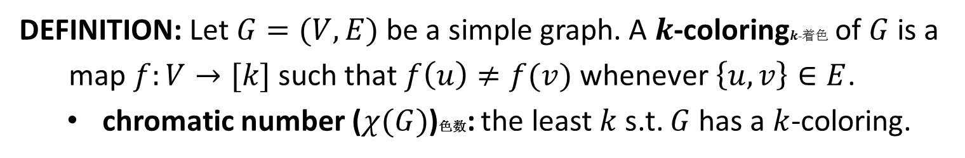

Graph Coloring
DEFINITION: Let $G=(V,E)$ be a simple graph. A $k$-coloring$k$-着色 of $G$ is a
map $f:V→[k]$ such that $f\left(u\right)≠f(v)$ whenever $\left\{u,v\right\}∈E$.
chromatic number ($χ(G)$)色数: the least $k$ s.t. $G$ has a $k$-coloring.
$$χ\left(G\right)=3$$
The chromatic number is at least 3 because a; b; c is a circuit of length 3

Slide 18

Graph Coloring
DEFINITION: Let $G=(V,E)$ be a simple graph. A $k$-coloring$k$-着色 of $G$ is a
map $f:V→[k]$ such that $f\left(u\right)≠f(v)$ whenever $\left\{u,v\right\}∈E$.
chromatic number ($χ(G)$)色数: the least $k$ s.t. $G$ has a $k$-coloring.
$$χ\left(G\right)=4$$

Slide 19

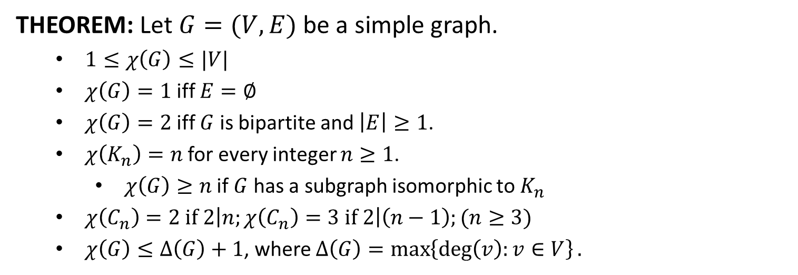






Graph Coloring
THEOREM: Let $G=(V,E)$ be a simple graph.
$1≤χ\left(G\right)≤|V|$
$χ\left(G\right)=1$ iff $E=∅$
$χ\left(G\right)=2$ iff $G$ is bipartite and $\left|E\right|≥1$.
$χ\left(K_{n}\right)=n$ for every integer $n≥1$.
$χ\left(G\right)≥n$ if $G$ has a subgraph isomorphic to $K_{n}$
$χ\left(C_{n}\right)=2 if 2\left|n;χ\left(C_{n}\right)=3 if 2\right|\left(n−1\right);(n≥3)$
$χ\left(G\right)≤Δ\left(G\right)+1$, where $Δ\left(G\right)=\max\left\{\deg\left(v\right):v∈V\right\}.$
$$1$$
$$1$$
$$2$$
$$2$$
$$1$$
$$3$$
$$2$$

Slide 20

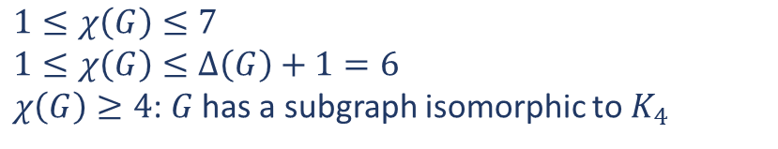
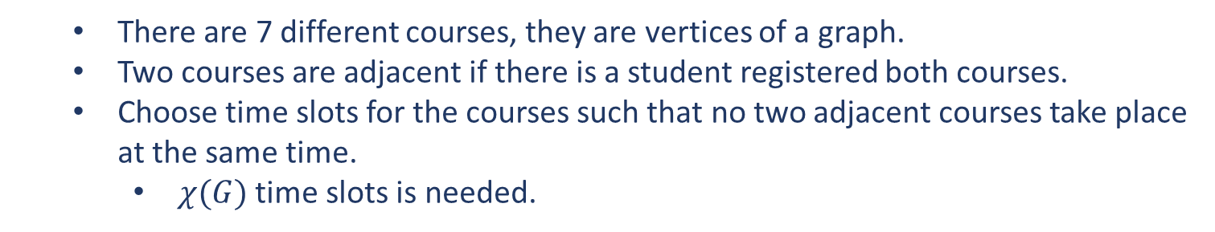
Application
PROBLEM: How can the final exams at a university be scheduled so that
no student has two exams at the same time?
$$χ\left(G\right)=4$$
There are 7 different courses, they are vertices of a graph.
Two courses are adjacent if there is a student registered both courses.
Choose time slots for the courses such that no two adjacent courses take place at the same time.
$χ(G)$ time slots is needed.
$$1≤χ\left(G\right)≤7$$
$$1≤χ\left(G\right)≤Δ\left(G\right)+1=6$$
$χ\left(G\right)≥4$: $G$ has a subgraph isomorphic to $K_{4}$

Slide 21
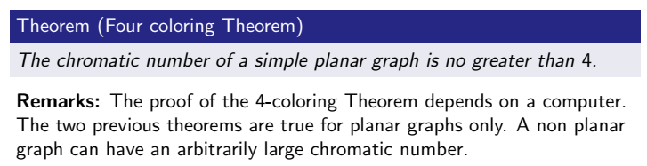
4-coloring Theorem

Slide 22
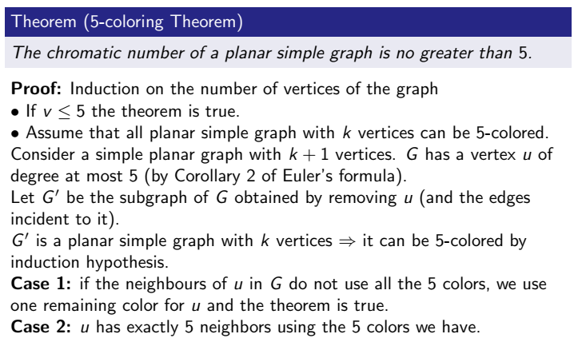
5-coloring Theorem*

Slide 23
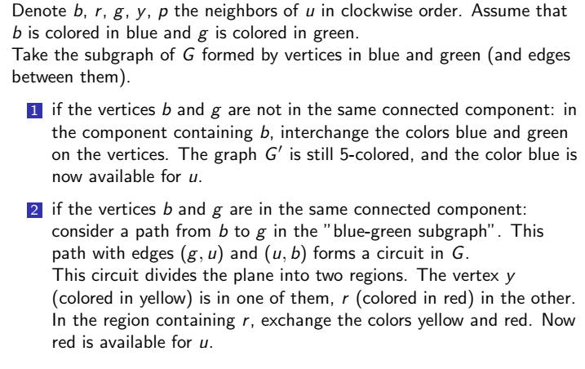
5-coloring Theorem*

